Slide 1
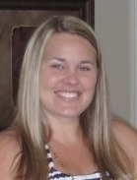
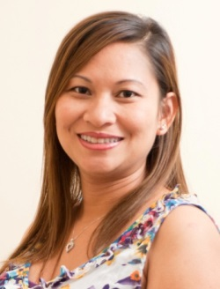
Houston Community College System
Coleman College for Health Sciences
Diagnostic Medical Sonography Program
1919 Pressler St. Room 711
Houston, TX 77030
HCCS homepage: http://www.hccs.edu
Program Website: Diagnostic Medical Sonography | Houston City College
Elizabeth Ho, DHSc, RDMS
Program Director
Elizabeth.ho@hccs.edu
713-718-7345
Lucy Quinn, BA, RDMS
Clinical Coordinator
Lucy.Quinn@hccs.edu
713-718-7343
Notes:
Hello, my name is Elizabeth Ho, Program Director of the Diagnostic Medical Sonography program at Houston Community College, Coleman College for Health Sciences. Before we begin, I like to say thank-you for your interest in this program.
I want to share with you this power point presentation with overview of the sonography profession, information of this program, and the admission steps to get into this program.

Slide 2
What is a Sonographer?
Allied Health professional that uses high frequency sound (ultrasound) to produce dynamic visual images of organs, structures, and blood vessels of the body to assist physicians in making a diagnosis.
Multiple area of specialization within Sonography
  Abdomen (AB)
  Breast (BR)
  Echocardiography
    Adult Echocardiography (AE)
    Fetal Echocardiography (FE)
    Pediatric Echochardiography (PE)
  Musculoskeletal (RMSK)
  Obstetrics and Gynecology (OB/GYN)
  Pediatric Sonography (PS)
  Vascular Technology (VT)
Our program covers general concentration areas
  Abdominal-extended concentration
  Obstetrics and gynecology sonography concentrations
Notes:
Before we go into details about the program, I wanted you to be aware of what a sonographer is. A sonographer is an Allied Health professional that uses high frequency sound (ultrasound) to produce dynamic visual images of organs, structures, and blood vessels of the body to assist physicians in making a diagnosis.
When people hear or think of a sonographer, they automatically think of scanning pregnant women and looking at babies. In reality, sonographers can be specialized in multiple areas. Sonographer can scan most structures within the body, from head to toe. This slide lists most of the common specialty which a sonographer can be specialized in.
Our program covers the abdominal-extended and the OB/GYN concentration. We also include small parts and introduction to Doppler Sonography.

Slide 3
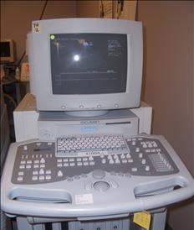
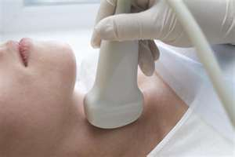
What Else Sonographers Do?
Perform high quality sonographic exams
  Requires an in-depth knowledge of:
    ultrasound equipment operation (physics/instrumentation)
  Anatomy / physiology / pathology & sectional anatomy
  Sonographic appearances of normal / abnormal anatomy including hemodynamics
Follow established exam protocols and use critical thinking during the exam to produce diagnostic studies
Notes:
Addition to scanning patients, we must know the how to operate the ultrasound equipments. By knowing the physic components within the ultrasound system, a sonographer is competent in taking proper images for the radiologists to read. An example of this is taking pictures with your cameras or cell phones. You can zoom-in and out or change the different settings to make your pictures better. If you don’t know how to manipulate those buttons on your camera, your images will not be beautiful or turn out the way you would like it to be. As a sonographer, it is really important that you provide proper image quality to the radiologists so they can make accurate diagnosis for the patients. If you perform a poor quality exam, more likely, the radiologists will miss pathologies and patients will be at risks.
Additional to knowing the ultrasound equipment, sonographer must know the anatomy and physiology of the human body. Textbooks tend to cover anatomy based on two dimensions: longitudinal and transverse plane. With ultrasound, sonographers can look at an anatomy in different angles. We use the transducer, which is hand-held device, to look into the patient’s body and be able to look at an organ in all different angles or directions. Because of this, a sonographer must be comfortable with the human anatomy and be able to picture the organ in 3 dimensional as he or she scans.
Another important factor that the sonographer must know is the physiology, including hemodynamic, and pathology of the human anatomy. A sonographer is the person who does the investigation for the radiologists. If we see any abnormalities in the patients as we scan, we must report our finds to the radiologists so they can make proper decision and treatment for the patients.
Concerning hemodynamic, ultrasound is the only system that can estimate the velocity of blood flow in the body. It requires knowledge of Doppler concept and application. Our program does include introduction of Doppler concepts in the curriculum.
Also, sonographer must follow established exam protocols and use critical thinking during an exam to produce diagnostic studies. As you can see, not all patient’s anatomy are alike. My liver will not look like your liver because the size, shape and texture are different. With this in mind, every patient you scan will have different anatomy, therefore, you have to use critical thinking and alter your scanning techniques to make sure that you produce optimal image quality and protocol to reflect what you see. Every patient that comes in will be a new challenge for you to scan.

Slide 4
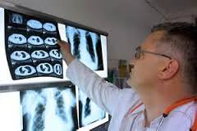
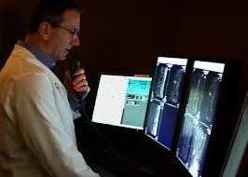
What Sonographers Do Additionally
Office tasks
  filing, answering phones, fill out forms, maintenance of patient records, etc.
Computer systems
  patient data entry/retrieval, exam data, image storage, etc.
History
Now
Notes:
Sonographers don’t just scan patients. It is their duty to also perform office tasks such as filing, answering phones, filling out forms, maintenance of patient records, and etc.
Sonographers also need to have basic computer skills. With this electronic world, everything is done electronically. If you are computer illiterate, I would recommend that you take a computer class to learn about basic computer skills.

Slide 5
What Sonographers Do Ultimately
Direct Patient Care
  Spend significant amounts of time with patients
    Lifting, moving, positioning assisting patients before, during, and after the exam
    Deal with vomiting, fainting, dizziness, oxygen, IV fluids, urine/ ostomy bags, bleeding, uncooperative patients, complications during exam, and patient/family questions
    Deal with sensitive areas such as breast, scrotal, penis, transvaginal, and transrectal exams
    Loss of life
    Patient education (no diagnosing!)
Work independently and as part of the health care team (physicians, nurses, etc.)
  physicians rely on your scanning expertise, and knowledge of anatomy
Notes:
There are more things that sonographers do. We ultimately take care of our patients before, during, and after the exam. We transport and care for them in any condition that they are in.
We also deal with their family members and work with the health care team.

Slide 6
TECHNICAL STANDARDS
The technical standards have been established through consideration by faculty and consultation with the following sources:
  The Vocational Rehabilitation Act
  The Americans with Disabilities Act
  Guide for Occupational Information
  Dictionary of Occupational Titles
  Occupational Skills Standards Project from the National Health Care Skills Standards Projects.
Notes:
Technical Standards are important factors that we would recommend you have prior to coming into this program. It includes physical demands, motor skills, and sensory/observational skills.

Slide 7
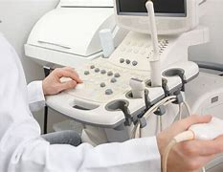
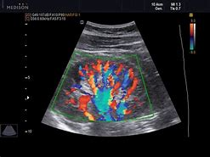
Physical Demands
Candidates must have the emotional and physical health sufficient to meet the demands of the position. Strength must be sufficient to lift some patients, move heavy equipment on wheels (up to approximately 500 lbs), and to move patients in wheelchairs and stretchers. The candidate must also be able to maintain prolonged arm positions necessary for scanning. The following list is for additional technical standards related to the physical demands of Diagnostic Medical Sonographers.
  Lift more than 50 pounds routinely
  Push and pull routinely
  Bend and stoop routinely
  Have full use of both hands, wrists, and shoulders
  Distinguish audible sounds
  Adequately view sonograms, including color distinctions
  Work standing on their feet up to 80% of the time
  Interact compassionately and effectively with the sick or injured
  Organize and accurately perform the individual steps in a sonographic procedure in the proper sequence
Notes:
Physical Demand: Candidates must have the physical demands to help our patients. More patients are getting obese now-a-day and we must be fit to move them from one area to the next. Sometimes, patients are too ill to come to the department to get scan, so we have to push the ultrasound system to their room to scan them. Being physically fit is necessary for this program.

Slide 8
Motor Skills
Must possess sufficient motor function to elicit information from patients by palpation, auscultation, percussion, and other evaluation procedures. Candidates must be able to execute motor movements including the physical/dexterity strength to stand and ambulate and possess the physical/dexterity strength to lift and transfer patients. Candidates must also have the physical strength to perform cardiopulmonary resuscitation.
Diagnostic Medical Sonography procedures require coordination of both gross and fine muscular movements, equilibrium, and functional use of the senses of touch and vision. For this reason, candidates for admission to the Program of General Diagnostic Medical Sonography must have manual dexterity and the ability to engage in procedures involving grasping, pushing, pulling, holding, manipulating, extending and rotating.
Notes:
Motor Skills: Candidates should have sufficient motor function so that they are able to execute movements required to provided general care and treatment to patients in all health care settings.

Slide 9
Sensory/Observational Skills:
Candidates must be able to observe demonstrations and participate in laboratory experiments as required in the curriculum. Candidates must be able to observe patients and be able to obtain an appropriate medical history directly from the patient or guardian. Such observation requires the functional use of vision, hearing, and other sensory modalities. Candidates must have visual perception which includes depth and acuity.
ADA Counselor:
https://www.hccs.edu/support-services/ability-services/ada-counselors/
Notes:
Sensory/Observational Skills: Candidates must be able to acquire the information presented through demonstrations and experiences in the basic and profession’s sciences. He or she must be able to observe a patient accurately, at a distance and close at hand, and observe and appreciate non-verbal communications when performing an assessment and intervention or administering of treatment.

Slide 10
Sonographer Qualities
Strong professional qualities
  communicates clearly and effectively with patients, instructors, staff, and physicians
  medical ethics, strong work ethic, team member
  emotional stability and emotional maturity
Strong eye/hand coordination and ability to think in 3 dimensions
  appreciation for subtle changes/movements in imaged tissues
Able to apply didactic education to the clinical setting
Commitment to life-long learning and expansion of personal knowledge
  30 Continue Education Credit every 3 years
  Recertification every 10 years
Notes:
As a sonographer, you must have strong professional qualities. You need communicate clearly, effectively, and sensitively with other students, faculty, staff, patients, family, and other professionals. You must also have medical ethics, strong work ethic, and be team member.
Strong eye/hand coordination is really important in this field. As a sonographer, you hold the transducer with your right hand to scan the patient. Your left hand is used manipulate the buttons on the ultrasound system, and yet, your eyes are stuck on the screen monitor. You have to learn to multi-task in this field. Learning how to scan is like learning how to drive. As we teach you how to drive, we can tell you where the steering wheel is , where the break is , and where the acceleration pedal is. We can also explain to you that, with the engine on, if you step on the acceleration and turn the steering wheel to the right, your car will turn right. With that knowledge only, you think you made a smooth turn on your first attempt learning how to drive? The answer would be no. Most likely, you have to apply that concept and physically practice and practice until you gradually make a smooth turn while driving. The same idea will apply with learning how to scan with ultrasound. We will educate you about the ultrasound system, the human anatomy and pathologies, and protocol and techniques, but if you don’t practice and applying all of those concepts and actually scanning volunteers, you will not be able to scan efficiently. Strong eye-and-hand coordination is very important in this field and it’s a concept that you must practice in order to gain. If you get accepted into this program, please consider investing times in the lab to practice scanning.

Slide 11
Researching Sonography
Talk to practicing Sonographers
  How did they get interested in the profession?
  Where did they go to school and why?
Talk to Prior students
  Ask about their classroom (student) experiences
  Learning styles and technology for instruction
  Study habits and methods
Observational experience in the HCC Sonography lab.
  Email Ms. Lucy Quinn (Lucy.Quinn@hccs.edu) for the volunteer schedule.
    Volunteers can see how lab courses are set up
    Volunteers can ask questions from the current students in the DMSO program
    Volunteers can lay down and get scanned
Talk to Medical Sonography department supervisors
  expectations of new hires/credential requirements
Notes:
Before you apply into this program, we want you to do some research and make sure that this is exactly what you wanted to do.

Slide 12
Accreditation
Institutional Accreditation
  Regional Accreditation: HCCS is accredited by Southern Association of Colleges and Schools (SACS)
    Courses are transferable to other Universities or Colleges
Program Accreditation
The Abdomen-Extended and Obstetrics & Gynecology DMS Program at Houston Community College is accredited by the Commission on Accreditation of Allied Health Education Programs (www.caahep.org) upon the recommendation of the Joint Review on Education in Diagnostic Medical Sonography (JRC-DMS).
CAAHEP JRC-DMS
9355 - 113th St. N, #7709 P.O. Box 2050
Seminole, FL 33775 Ellicott City, MD 21043
727-210-2350 443-973-3251
Notes:
Our college is accredited through SACS which means that all courses taken here are transferable to other universities or colleges. This is beneficial if you want to advance in your educational goals.

Slide 13
CAAHEP accreditation ensures…
Program has met the Standards and Guidelines for an Accredited Educational Program for the Diagnostic Medical Sonographer
    program accepts responsibility for didactic and clinical education for the student throughout the length of the program
    Ensure quality sonography education that service the public
Ability to apply to take American Registry for Diagnostic Medical Sonography (ARDMS) exams immediately upon successful completion of the program
    HCCS assures graduates to take ARDMS exams presently due to rigid prerequisites required prior to acceptance to program
Notes:
Being accredited means that we are responsibility for your didactic and clinical education and that you can take the registry after completion of the program.
Please note that the prerequisites for this program is required because of the accreditation standards.

Slide 14
Program Mission Statement
To prepare competent entry-level general sonographers in the cognitive (knowledge), psychomotor (skills), and affective (behavior) learning domains for the abdominal-extended and obstetrics and gynecology sonography concentrations. The program accomplishes this objective by integrating didactic and clinical instruction in facilities that are conducive to learning and working to achieve institutional goals.
Notes:
Our mission is to prepare you to be competent entry-level general sonographers in the cognitive (knowledge), psychomotor (skills), and affective (behavior) learning domains for the abdominal-extended and obstetrics and gynecology sonography concentrations. The program accomplishes this objective by integrating didactic and clinical instruction in facilities that are conducive to learning and working to achieve institutional goals.

Slide 15
* IMPORTANT NOTE*
Admission to the Sonography Program does not guarantee that you can be taught to scan
Learning to perform sonograms (scan) requires instruction, practice, skill and talent
  also requires demonstration of excellent professional qualities
    communication, patient care, decision-making, critical thinking, etc.
Notes:
Admission to the Sonography Program does not guarantee that you can be taught to scan. You must practice and practice to be a good scanner.

Slide 16
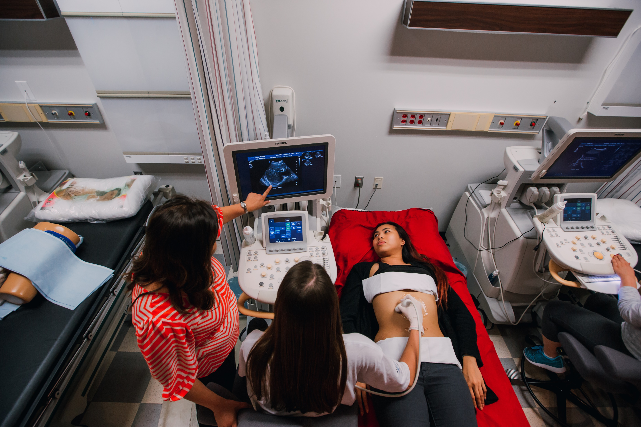
HCCS Sonography Program
Degree/major earned after completion of the program
  Associate Applied Science Degree (AAS)
  Advanced Technical Certificate (ATC)
Notes:
This program is full-time four consecutive semesters.
Once you finish the program, you will earn the advance technical certificate or and associate degree, which you have applied for.
In this program, student to instructor ratio for didactic courses vary course by course, clinical courses are usually 1-5 students per clinical site.

Slide 17
What’s the difference between AAS and ATC?
If you want to work as a sonographer in a health care facility, it doesn’t matter what degree you have. You only need to be registered Sonographer.
If you want to progress in your career, you will need a higher degree, preferable a bachelor degree or higher. Does not need to be in ultrasound.
  Management
  Sale
  App specialist
  Education
Notes:
Which degree is better? The associate degree or the advanced technical certificate? It really depends on what you want to do. If you want to work as a sonographer in a health care facility, it doesn’t matter what degree you have. You only need to be a registered Sonographer by passing the registry.
But if you want to progress in your career, you will need a higher degree, preferable a bachelor degree or higher. A higher degree does not need to be in ultrasound. It can be in health management, sale, education, etc.

Slide 18


Do you have an Associate Degree in Allied Health (2-year education program in a patient-care related area) or a Bachelor’s degree in any area?
You can apply for the Diagnostic Medical Sonography, Associate Applied Science Degree (AAS) Program
You can apply for the Diagnostic Medical Sonography, Advanced Technical Certificate (ATC) Program
Notes:
Since the program has two route, which one will you apply for? You are qualified to apply for the Advanced technical certificate if you already have an associate degree in Allied Health or a bachelor degree. Otherwise, you will need to apply for the associate program.

Slide 19
Diagnostic Medical Sonography, AAS Program
Degree Plan
Prerequisites | Semester 1 | Semester 2 | Semester 3 | Semester 4 | Semester 5
HPRS 1201 Intro to health Professionals BIOL 2301 and BIOL 2101 (formerly BIOL 2401) – Anatomy & Physiology I (LEC/LAB) OR higher MATH 1314 – College Algebra or higher ENGL 1301 – English Composition I OR higher OR Speech | DMSO 1210 Intro to Sono DMSO 1441 Abdominopelvic Sono DMSO 2101 Basic US Physics DMSO 1355 Sono Pathotophysiology DMSO 1351 Sono Sect Anatomy | DMSO 2441 Sono of Abdominopelvic Patho DMSO 2405 Sono of OB/GYN DMSO 1342 Intermediate US Physics DMSO 1266 Sono Practicum I PHYS 1305 Elementary Physics I XXXX #1## General Education Elective | DMSO 2351 Doppler Physics DMSO 2342 Sono High Risk OB DMSO 2253 Sono of Superfical Structures DMSO 2266 SonoPracticum II Phil 2306 Into to Ethics | DMSO 2243 Advanced US Physics DMSO 2130 Advanced US and Review DMSO 2467 Practicum III | Graduated and working in the field
Time management is extremely important in order to complete all these classes successfully.
It is highly recommended that all Core courses (courses in blue) be completed before starting the DMS program.
XXXX #1##General Education Elective
https://catalog.hccs.edu/preview_program.php?catoid=7&poid=3632&hl=core+curriculum&returnto=search
Notes:
Here is the curriculum for the associate degree program.
Courses in green fonts are considered as academic courses, which means they are not related to sonography courses.
The first column listed the prerequisite courses. Students must complete these courses before applying to the program.
The elementary physics, general elective, and the ethics course are considered as co-requisite course. Co-requisite means you can take these courses while you are in the program, but we do not recommend it. We highly recommend that you treat theses as a pre-requisite course. We recommend that you take these courses before you join the program so that you don’t have to worry about while you are in the program.
Courses in black fonts are sonography courses.
If you plan to take the elementary physics, general elective, and the ethics course in the semester listed here, you will struggle and may not be able to graduate on time. Note that in the fourth semester, you will have to take two review courses and a practicum course. If you plan to take an academic course in this semester, you will lease likely be successful because you will not have full concentration to study for the registry review.

Slide 20
Physics Course
Needing 4 credits
  For the PHYS 1305 and the 1 credit elective option (4 Total Credits required) students can use any general education course (Reading, Writing, Math, or Science, 3 credits). example: CHEM, GEOL, PSYC, ENGL, MATH, etc. to fulfill the missing 1 credit elective.
  Or if they have PHYS 1105 lab, 1 credit to add to the PHYS 1305 to equal (4 Total Credits required)
  Or if they have PHYS 1405 lecture and lab (4 Total Credits required)
Notes:
For your academic course, you can take PHYS 1305 and the 1 credit elective or take Physics 1305 with Physics 1105 lab, or take Physics 1405 with lab to account for the four credit hours.
The elective course are listed listed on the link in this slide.

Slide 21
Diagnostic Medical Sonography, ATC Program
Degree Plan
Prerequisites | Semester 1 | Semester 2 | Semester 3 | Semester 4
MATH 1314 – College Algebra or higher PHYS 1305 – Introductory Physics I or higher OR Physics for Allied Health OR Radiographic Physics ENGL 1301 – English Composition I OR higher OR Speech BIOL 2301 and BIOL 2101 (formerly BIOL 2401) – Anatomy & Physiology I (LEC/LAB) OR higher | DMSO 1210 Intro to Sono DMSO 1441 Abdominopelvic Sono DMSO 2101 Basic US Physics DMSO 1355 Sono Pathotophysiology DMSO 1351 Sono Sect Anatomy | DMSO 2441 Sono of Abdominopelvic Patho DMSO 2405 Sono of OB/GYN DMSO 1342 Intermediate US Physics DMSO 1266 Sono Practicum I | DMSO 2351 Doppler Physics DMSO 2342 Sono High Risk OB DMSO 2253 Sono of Superfical Structures DMSO 2266 SonoPracticum II | DMSO 2243 Advanced US Physics DMSO 2130 Advanced US and Review DMSO 2467 Practicum III
Time management is extremely important in order to complete all these classes successfully.
Prerequisites- Compare course equivalencies at https://www.tccns.org/
Notes:
Here is the curriculum for the Advanced Technical Certificate program. You need to complete the prerequisites before applying to the program.

Slide 22
HCCS Sonography Program
Diagnostic Medical Sonography Program (DMSO)
    Begins in the fall and the spring semester
    Four consecutive semesters:
      Fall Cohort - Fall, Spring, Summer, and Fall semester (16 months long)
      Spring Cohort – Spring, summer, Fall, and Spring (16 months long)
    Full-time (Any day of the week)
      This program does not offer part-time courses
    Class Hours varies
      Can be daytimes, evenings, and weekends
    Clinical Hours varied (can be daytime, evening, nights, and weekend)
      Can be daytimes, evenings, nights and weekend
Notes:
This program is full-time program with four consecutive semesters. Lecture and lab classes can be offered during the day, evening, and weekend. Clinical can be offered during daytime, evening, nights, and weekend.
We accepted two cohorts, one in the fall and one in the spring semester.

Slide 23
Sonography Credit hours
Sonography is a full-time course of study should be student’s main focus in terms of time and resources
Clinical experience increases as program progresses
Lecture and clinical courses are integrated and correlated
Labs include peer scanning, live volunteers and ultrasound training simulator
HCCS student to instructor ratio
  Didactic courses: varies by course
  Clinical courses: 1-2 students per clinical site
Student must successfully complete all courses each semester to continue in the program
Passing score is 75
First semester
  14 credit hours
    includes clinical observation time at end of semester
Second semester
  13 credit hours
    2 clinical days per week
Third semester
  10 credit hours
    2 clinical days per week
Fourth semester
  7 credit hours
    4 clinical days per week
Notes:
This slide shows the overall lay out of our program. As you can see, as you progress in the program, the more clinical experience you will get. By the end of the program, you will be in the clinic more often, which prepares you for the workforce.
For you to progress in the program, you must make 75 or higher in every course.

Slide 24
Typical Week
Monday | Tuesday | Wednesday | Thursday | Friday
DMSO 1351 Lecture scheduled in-person 9 - 11 am | DMSO 1351 Lab Room 711 scheduled in-person 8 - 10 am | DMSO 1202 8-12 pm in-person |  | DMSO 1210 9 - 12 pm first 8 weeks scheduled in-person Second 8 weeks In-person Lab
DMSO 1441 Lecture scheduled in-person 12 - 3 pm |  | DMSO 1441 Lab Room 711 scheduled in-person 1:30 - 5:30 pm | DMSO 1355 Lecture scheduled in-person 4-8 pm
Notes:
Here is an exam of the schedule for one student, in a week. Classes colored orange are lab classes. It is highly encouraged for you to study if you are not in class.

Slide 25
Sonography Clinical Experience
Students are assigned to rotations in various hospital and office ultrasound departments
  Woodlands
  Katy
  West Houston
  Ford Bend
  Sugar Land
  Kingwood
  Clear Lake
  Texas Medical Center: http://www.texasmedicalcenter.org/about/
Clinical sites must meet JRC/DMS standards accreditation criteria
  Appropriate credentialed Registered Sonographers
  Appropriate case load
  Appropriate equipment
Notes:
We have many great clinical sites for you to rotate through. Clinical assignment is assigned randomly, not based on where you live and/or your preferences. You will be responsible for transportation, parking fees, and any fees associated to the assigned site. In this program, you may be rotated to 3-4 sites throughout the program.

Slide 26
Clinical Affiliates
Five of our affiliates are rated the Best Hospital in the U.S News & World Report
  http://www.bizjournals.com/houston/news/2015/07/21/u-s-news-world-report-ranks-houstons-best.html
    Houston Methodist Hospital
    Memorial Hermann Hospital-Texas Medical Center
    University of Texas M.D. Anderson Cancer Center
    Clear Lake Regional Medical Center
    Baylor St. Luke’s Medical Center
Notes:
We have sites that have rated the Best Hospital in the US News and World Report

Slide 27
Sonography Clinical Experience
Clinical competency is documented by clinical instructor/preceptor with frequent evaluation
Sonography faculty visit students at clinical sites on a regular schedule as required by JRC-DMS
Notes:
During your clinical rotation, you are required to comp-out or test on actual patients and evaluated by clinical instructors. Faculty will visit students on regular bases to ensure that proper training is occurred.

Slide 28
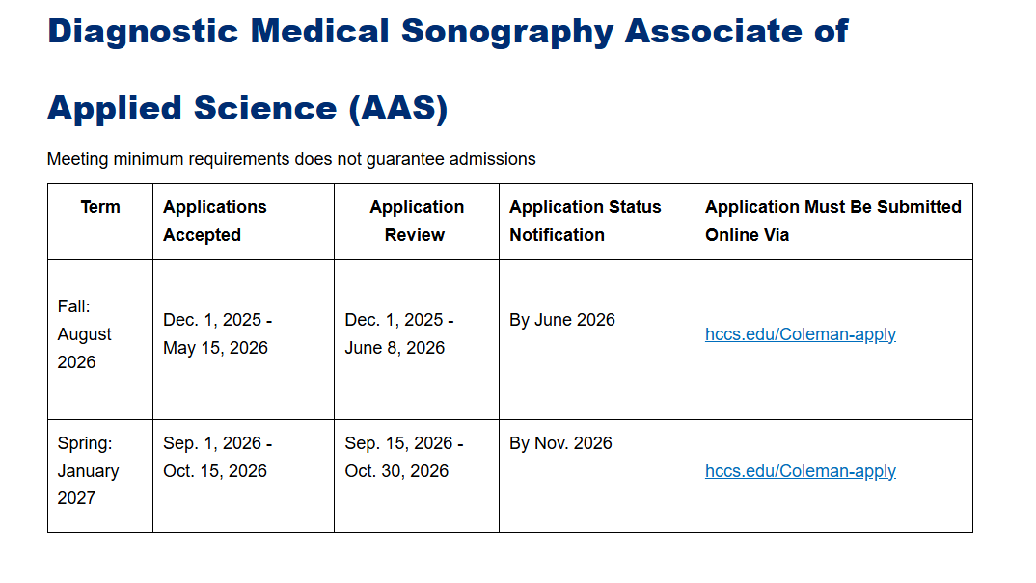
Step 1 - Required: Check Application Deadline
Final Deadline: As stated in the Admission Guide
  Make sure to complete all the following steps before applying for this program.
  We will not make exceptions for those who does not meet the requirements
Contact us after the Application Status Notification deadline
Notes:
Please review our website for application deadline and notification timeline. You can reach out us for updates after the application status notification deadline.

Slide 29
Getting Started at HCCS
Step 2 - Required:
Complete “HCCS Application for Admissions” on-line at https://www.hccs.edu/applying-and-paying/
  Only if no previous enrollment or testing activity has taken place at HCCS.
  Admission to HCCS does not mean automatic admission to the Sonography Program
Notes:
If you have never been a student at Houston Community College, please go into this website and input your information into our system. This is a free service.

Slide 30
Step 3 - Required: Transfer Transcripts to HCC
  If you have prior college education
  In the US - Transfer equivalencies for your particular school(s)
    https://tes.collegesource.com/publicview/TES_publicview01.aspx?rid=7dc792ae-36e5-4eac-a1f4-d52b0b1e7efa&aid=17697a2f-ccc2-4bcc-a710-9d702bba0f27
    Contact our advisor for consultation and review your transcript(s) and course equivalency
      David Pereida, David.pereida@hccs.edu or 713-718-5060
  Out of country - it needs to be evaluated course-by-course through an approve agency listed in the website below and through HCC evaluators
    https://www.hccs.edu/support-services/international-students/foreign-credentials/
    transcript from out-of-country needs to show 3 credit hours; it may take 4-6 weeks for HCC to evaluation these courses
Notes:
The next step is to make sure that you have all the prerequisites in place. You need to have an Associate Degree in Allied Health with direct patient care or a Bachelor’s degree in any area. If you don’t have any degree, you can go to the HCC website to find a health care program that offers an associate degree. Complete it and then apply for this program. If you plan to do this, I highly recommend that you look into the radiology program. Going through the radiology program would make it easier for you to transition your knowledge toward the sonography program.
Please make sure you read and understand all criteria on this slide.

Slide 31
Step 4 - Required: Complete Program Prerequisites
Applicant must have a 3.3 GPA or higher
Contact our advisor for consultation and review your transcript(s) and course equivalency-David Pereida, David.pereida@hccs.edu or 713-718-5060
Show proof of completion of the following courses prior to admission to the program:
AAS
    HPRS 1201 Introduction to Health Professions
    BIOL 2301 and 2101 Anatomy and Physiology (lecture and lab)
    MATH 1314 College Algebra
    ENGL 1301 Composition I
  Note that you will need to take the following three courses in addition to the sonography courses to earn the AAS degree. It is highly recommended that you take these classes before entering the program so you can focus on the study of sonography.
    PHYS 1305 Elementary Physics I
    XXXX #1## General Education: Electivehttps://catalog.hccs.edu/preview_program.php?catoid=7&poid=3632&hl=core+curriculum&returnto=search
    PHIL 2306 Introduction to Ethics
ATC
  General physics- PHYS 1401 (any Physics) or SCIT 1320 or SCIT 1420
  College algebra (any college level math or statistics)
  Communication skills (English, Speech, or Composition)
  Human anatomy and physiology (recommending I and II)
Notes:
Applicants must have a 3.3 GPA and all the prerequisites before applying to the program.

Slide 32
Step 5- Optional:
Complete DMSO 1210
We offer course DMSO 1210, Introduction to Sonography, to prospective students every semester
This course is not a prerequisite course.
Registration will be first come first, first served basis. Once it's full, we will not be able to enroll you.
Completing this course will earn you extra points toward your admission process based on the scale below.
  A - 8 points
  B - 6 points
  C - 4 points
Notes:
Please note that DMSO 1210 is not a prerequisite course. We offer this course every semester, and once it’s filled, you will need to wait until the next offering to enroll in it. We will not be able to add you to this course once it’s full.

Slide 33
Step 6 - Optional:
Complete DMSO 1210
Application for Spring 2027 on onward
Rubric CEC 1198 - Critical Thinking for Standardized Tests
Rubric CEC 1196 - Study Skills for Student Success
Rubric CEC 1197 – Successful Test Taking
Completing this course will earn you extra two (2) points for each course toward your admission process
HCCS.edu/CHP
713-718-7796
Hcc-chp@hccs.edu

Slide 34
Step 7 - Required: HESI Exam
Student must take the following sections of the HESI exam to be eligible to apply for Sonography program.
  Critical Thinking
  Grammar
  Reading Comprehension
  A&P
Must be done before applying to the program
Contact Coleman Testing Center at coleman.testing@hccs.edu or 713-718-5170 to schedule an appointment.
The payment of $75.00 must be made by either credit or debit card.
Visit https://evolve.elsevier.com/cs/
Create a username and password
DEPT ID# is not needed
Notes:
Compete the HESI exam. The higher the score, the better for your application.

Slide 35
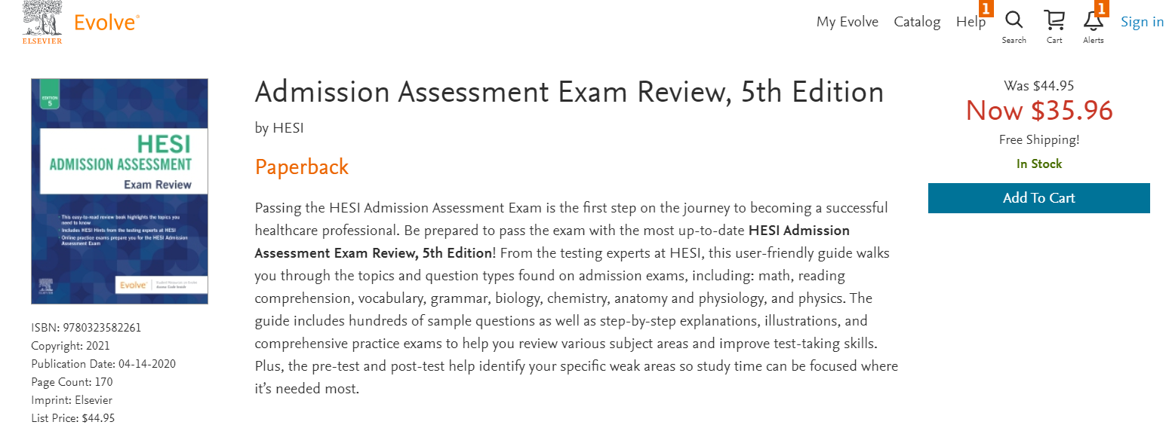
Step 8 - Optional : HESI Exam
Review Material
https://evolve.elsevier.com/cs/product/9780323582261?role=student
Notes:
This is not required for you to have, but if you want to review for the HESI exam, here is the review material for it.

Slide 36
Step 9 - Required: Immunization Record
Completion of the followings.
Hepatitis B immunization series valid within 10 years
  Fast track is accepted
  Traditional route may take up to 6 months
  Upon completion of the hep B series, a titer must be taken to prove immunity (a titer can only be taken 4 to 6 weeks after shot)
  Titer is valid within a year
MMR (measles, mumps, and rubella)
  2 shots completed
  a titer must be taken to prove immunity (a titer can only be taken 4 to 6 weeks after last shot)
  Titer is valid within a year
Varicella
  2 shots completed
  a titer must be taken to prove immunity (a titer can only be taken 4 to 6 weeks after last shot)
  Titer is valid within a year
It is the responsibility of the student to check the results of the titers before submitting to Complio. It must show positive to be eligible to apply. If it shows negative, do not upload it to Complio. If you have negative titers, you need a booster and a repeat of your titers 4-6 weeks later.
  If you do not have records of your Hep B, MMR, and Varicella shots, you do not have to show your shot records, but must show titers that prove you have immunity.
Notes:
You must complete your Hep B, MMR, and Varicella with titer before applying to the program. The titer must be positive, and be done within a year of the application.

Slide 37
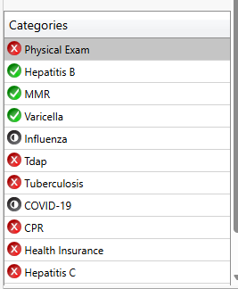
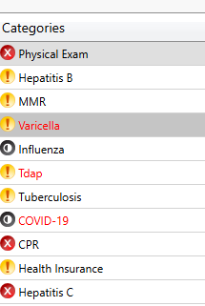
Step 10 - Required: Immunization Record cont.
Upload Hep B, MMR, and Varicella in Complio - http://houstoncccompliance.com/
Apply for the Tracking package- Immunization Package (Coleman Health Sciences Tracking package)
Make sure you get Approved under Status
Ignore all other requirements in Complio
Acceptable
Not Acceptable
Notes:
Since you are not yet a student of our program, we cannot accept any confidential documentations. We need you to upload it on Complio for us to review.
When creating Complio account, select the Immunization Package in Complio.
You only need to upload the Hep B, MMR, and Varicella with titer documentations. Please disregard all other requirements in Complio.

Slide 38
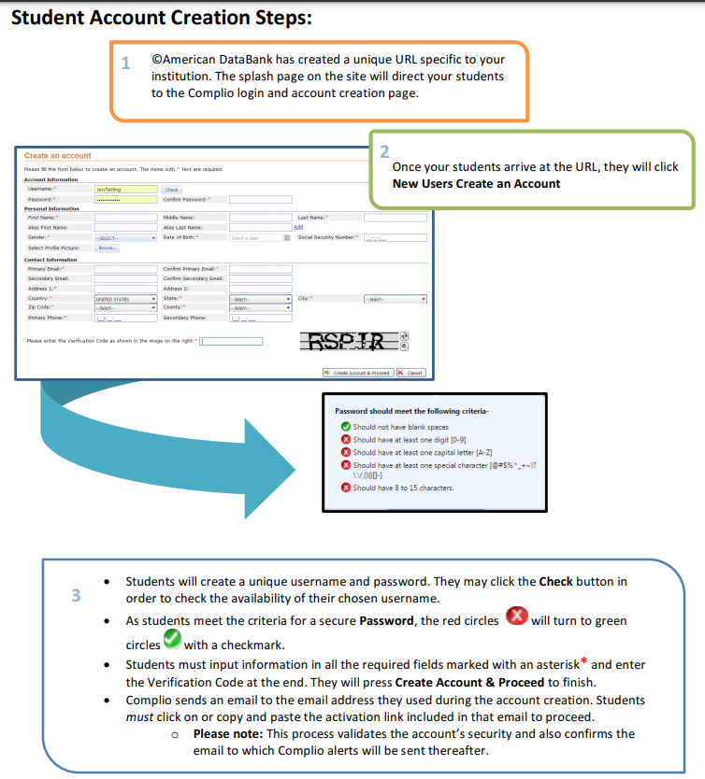
Step 10: Creating an account in Complio
- Make sure your name matches your ID
- Make sure your first and last name are in the correct box. We found that many students input this incorrectly.
Notes:
Here is the instructions of how create a Complio account. You are responsible for the cost of this account. Please make sure your name matches your ID and that you have the first and last name in the right box. Many students made this error, and we can’t match them with their application.

Slide 39
FYI: Immunization Record cont.
Once admitted into the program:
  PPD skin test
    Will be taken yearly
  Tdap valid within 10 years
  Hepatitis C
  Flu shot
  Physical Examination
  Drug Screen
  Background check
Notes:
Once you are in the program, we do ask for more documentation of other immunization records.

Slide 40
FYI: Immunization Record cont.
Covid Vaccination
  Most healthcare facilities do require the vaccine as a condition of employment, volunteering, or student clinical placement.
  If a student chooses not to disclose their COVID-19 vaccination status or is not vaccinated, HCC may not be able to place the student in clinical rotations.
  HCC will work to place such students into a clinical site that does not require the vaccine, provided such a site is available and HCC has an active affiliation agreement in place that meets the necessary conditions to provide an appropriate learning opportunity for the student. However, HCC cannot guarantee that clinical sites that do not require the COVID vaccine will be available at the time the student requires placement.
  At this time, many healthcare facilities are not accepting religious or medical exemptions for the COVID-19 vaccine for clinical students.
  If a student chooses not to receive or to provide proof of COVID-19 vaccination and no clinical sites are available to accept the student that do not require the COVID-19 vaccination, the student’s progression in the program and graduation will be delayed or stopped all together.
  If a student cannot be timely placed in a qualifying clinical site, a student may not be able to complete the program.
Notes:
Some clinical sites still require prove of Covid vaccinations. If you don’t have this vaccination, you can’t be assigned to those sites. Note, if we can’t find a site for you, there may be a delay in your education.

Slide 41
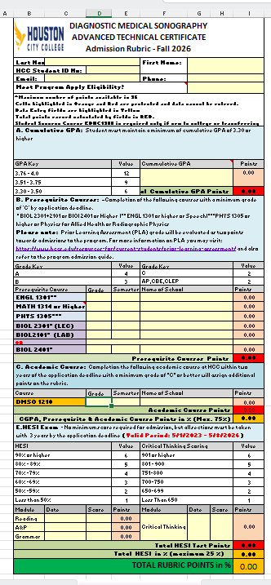
Step 11 - Required: Compete the Admission Rubric
Complete the Admission Rubric
  https://www.hccs.edu/programs/areas-of-study/health-sciences/diagnostic-medical-sonography/
  Make sure your name matches your ID
  Email is correct and active; check often
  Link your HCC email to your personal email
  Phone number is active and create/clear out your voice mail
Notes:
Once you have completed step 1-4, the next step is to complete the admission rubric so you know where you stand in the application process.
Things to consider:
If you have taken a class more than once, make sure to input the one with the higher grade.
The GPA is cumulative. With multiple transcripts, you will add and divide to get the GPA
AP, CBE, and CLEP credits counts as 2 points

Slide 42
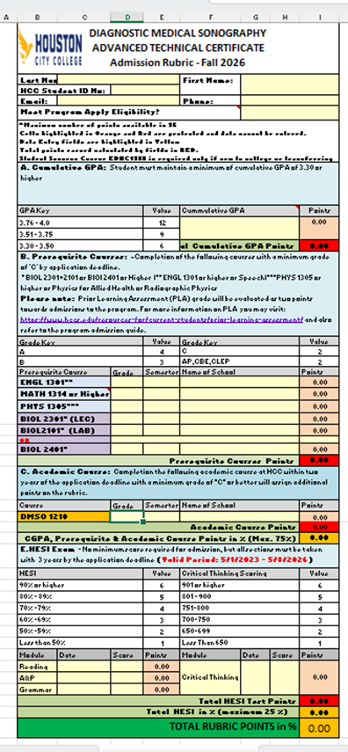
Step 12 - Optional : Meet the Advisors
Contact our advisor for consultation and review your transcript(s) and all paperwork:
  David Pereida
    David.pereida@hccs.edu or 713-718-5060
  If you take a prerequisite course twice, make sure to let Mr. Pereida knows to select the one with the higher grade
  You may speak directly with a Coleman campus advisor via
  Zoom link (https://us02web.zoom.us/j/86185970156) Monday through Thursday, 9 a.m. - 6 p.m. and Friday, 8 a.m.- 5 p.m., or in-person by visiting the campus. You may also email coleman.advising@hccs.edu, or leave a message at 713.718.7145.
Notes:
We recommend that you meet with our advisor, David Pereida and go through the rubric together. This way, you will see the most accurate number for your Admission Rubirc.

Slide 43
Step 13 - Required: Compete the Online Application
Complete the online application
  https://forms.hccs.edu/PerfectForms/PresentationServer/App.aspx/Play/7XAgAgIG?f=7XAgAgIG
Make sure your information is consistent with Complio and the Rubric
Notes:
You can apply into the DMSO program online. Again, please make sure all information are inputted correctly.

Slide 44
FYI – Online Application
Application Submission > you get an updated email
Prescreen > you get an updated email
Advisor review > you get an updated email
Program Review >
If Qualified/In progress approved, Admission Ranking > you get an updated email
If selected for admission, Letter of Intent > Complete & Close/ Denied & Close you get an updated email

Slide 45
Step 14 - Required: Wait for Results
Contact us after the Application Status Notification deadline for results if you don’t hear from us
Notes:
Please review our website for application deadline and notification timeline. You can reach out us for updates after the application status notification deadline.

Slide 46
STUDENT SELECTION
Students are selected based on a point system, which includes several different factors. The grades the applicants attained in courses that are required in advance of the program including:
Academic Performance 75%
  Overall GPA
  Cumulative GPA: Student must maintain a minimum of cumulative GPA of 2.50 or higher
  Grades for all the prerequisite courses
  HESI Exam 25%
Completion of Immunizations
Note: If you don’t get accepted in the program, you need to improve your academic performance or the HESI exam score.
Notes:
How we select our students is based on a point system. Count the academic performances as 75%, HESI exam as 25%, and completion of the immunizations.
If you did not get accepted into the program, more likely, your score is not high enough. Please improve your academic grades or your HESI score.

Slide 47
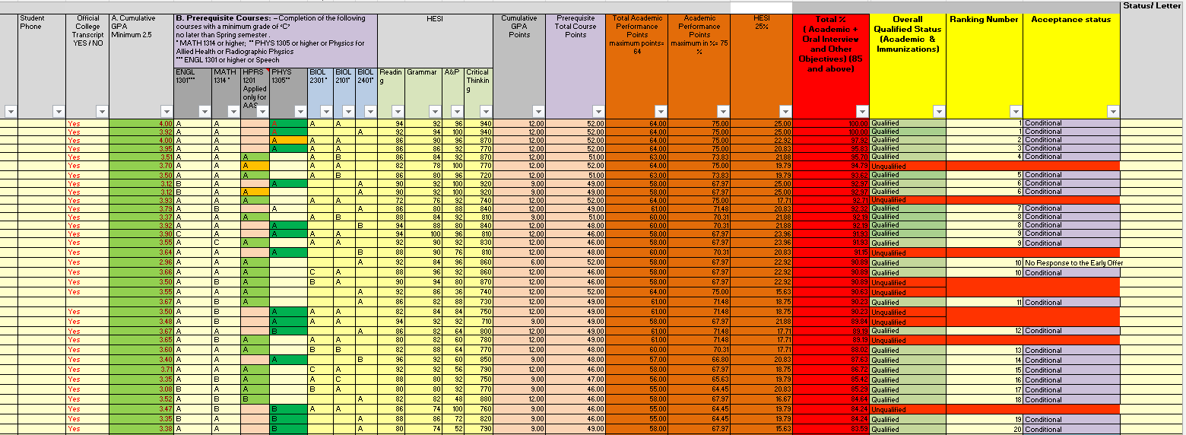
Program Rubric
Example for Class of 2023
Notes:
This is and example of our spreadsheet. We select the highest rating students.

Slide 48
Student Selection Process
The DMSO program receives an average of 200+ applications each year
The program accepts up to 26 students in the fall and 16 in the spring semester
  Mixture of ATC and AAS students
  Early and final deadline
Students with all high score will be selected based on the highest cumulative GPA
Students have 5 days to respond to the acceptance letter. After the 5th day, program has the right to pass that offer to the next prospective student
If accepted, students must pay for tuition at least three weeks before the first day of school and attend a program orientation/registration session is required before the first day of school
Notes:
We accept 26 in the fall semester and 16 students in the spring semester. If two students have the same score, we will select the one with the higher GPA.
If you get accepted into the DMSO program, you must attend the program orientation to secure your seat.

Slide 49
Student Selection Process
Once accepted, a condition of clinical assignment is the passing of a criminal background check and drug screening at an agency approved by HCCS after acceptance but prior to clinical observation in first semester.
Background check: If you have anything more than parking tickets, you need to declare it with the ARDMS
  http://www.ardms.org/Discover-ARDMS/compliance/Pages/default.aspx
  This process can take up to 6 months to complete. You will not be able to enroll in the spring semester if you are not cleared in your background check
Notes:
We do background check and drug screen after admission. If you have something on your record, please make sure to declare with the ARDMS before applying to the program.

Slide 50
Work Eligibility Requirements
The Diagnostic Medical Sonography program requires participation in clinical rotations in order to complete the program. In order to participate in clinical rotations at our affiliate sites, certain background information must be verified. Students participating in clinical rotations must meet the same background verifications as clinical staff. For that reason, we require students to submit the following required background information before admission/enrollment in the program is complete:
1. Social Security Number Verification or SEVIS number
2. Criminal Search (7 yrs. or up to 5 criminal searches)
3. Violent Sexual Offender and Predator Registry Search
4. OIG List of Excluded Individuals/Entities
5. GSA List of Parties Excluded from Federal Programs
6. US Treasury, Office of Foreign Assets Control (OFAC), List of Specially Designated nationals (SDN)
7. State Exclusive List www.hhsc.state.us
Verification of this information is the financial responsibility of the student and must be completed through the program-approved vendor, Castle Branch.
Notes:
Clinical sites requires our students to be legal residents with social security numbers, student visa, or SEVIS number. With out it, we won’t be able to assign you your clinical rotation and you will not be able to continue in the program.

Slide 51
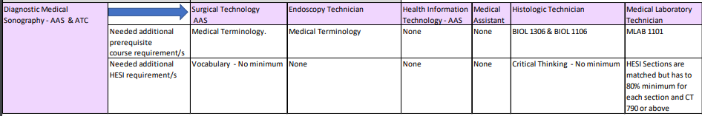
Back-Up Plan
Surgical Technology
Endoscopy Technician
Health Information Technology
Medical Assistant
Histologic Technician
Medical Laboratory Technician
Commission on Accreditation of Allied Health Education Programs (CAAHEP)
programmatic postsecondary accrediting agency
https://www.caahep.org/
Look for other ultrasound school in the Houston Area
Notes:
Due to limited lab and clinical spaces, we can not accept everyone who applied to the program. We encourage you to have a backup plan. Here are a list of other programs we have at HCC which have similar prerequisites as ours. You may consider going through these program while waiting for our program.

Slide 52
Approximate Program Costs
Diagnostic Medical Sonography, ATC Program
Estimation Tuition for 2022
Go to HCAD.org to determine if you are in-district or out-of-district
DMSO = 44 credit hours
Credit Hours | Prerequisites | Fall I 14 | Spring 13 | Summer 10 | Fall II 7 | Total 45
In-District | $1020.00 | $1187.00 | $1103.50 | $851.00 | $597.50 | $4.759.00
Out-District | $2170.00 | $2531.00 | $2351.50 | $1811.00 | $1269.50 | $10,133.00
Out-State | $2730.00 | $3182.00 | $2956.00 | $2276.00 | $1595.00 | $12,739.00
Estimated on 9-22-21
Notes:
Tuition is based on where you live. You will need to contact the registrar office to determine if you are in-district, out-of-district, or out-of-state. Here is the estimated cost for the tuition only for the Advanced Technical Certificate program.

Slide 53
Approximate Program Costs
Diagnostic Medical Sonography, AAS Program
Estimation Tuition for 2022
Go to HCAD.org to determine if you are in-district or out-of-district
DMSO = 64 credit hours
Credit Hours | Prerequisites 12 | Fall I 14 | Spring 17 | Summer 14 | Fall II 7 | Total 45
In-District | $1020.00 | $1187.00 | $1437.50 | $1187.00 | $597.50 | $5429.00
Out-District | $2170.00 | $2531.00 | $3069.50 | $2531.00 | $1269.50 | $11,571.00
Out-State | $2730.00 | $3182.00 | $3860.00 | $3182.00 | $1595.00 | $14,549.00
Estimated on 9-20-21
Notes:
Here is the estimated cost for tuition only for the Associate program.

Slide 54
Additional Costs
Textbooks | $2000
Trajecsys System- clinical requirement | $100
Complio - clinical requirement & Background Check | $100
Ultrasound Registry Review | $300
Society Of Diagnostic Medical Sonography Membership | $45
Uniforms | Varies
Physical Check and Immunizations | Varies
Background check and Drug screen | Varies
Health Insurance | Varies
Coleman College for Health Sciences campus parking | Varies
Transportation to campus and clinical sites | Varies
School Supplies including a laptop | Varies
Refer to HCCS website for additional information
Notes:
These are additional costs for you to consider/plan for before joining the program.

Slide 55
Additional Costs for Both Program
1st Semester: Fall
Required Courses | In District | Out of District | Out of State
15 Credited Hours | $ 1,015.50 | $ 2095.50 | $ 2343.00
Books | $ 1,062.89 | $ 1,062.89 | $ 1,062.89
Parking | $ 350.00 | $ 350.00 | $ 350.00
Lab Fees | $ 50.00 | $ 50.00 | $ 50.00
Liabilities Ins | $ 50.00 | $ 50.00 | $ 50.00
Total | $ 2,528.39 | $3,607.94 | $ 3,855.89
Notes:
This is the estimated total cost for everything in the first semester. It’s high because textbook is included at the beginning of the program. We will use the same textbook throughout the program, so you won’t have this cost moving forward.

Slide 56
Additional Costs for Both Program
2nd Semester: Spring
Required Courses | In District | Out of District | Out of State
13 Credited Hours | $ 882.50 | $ 1,818.50 | $ 2,033.00
Books | $ - | $ - | $ -
Parking | $ 350.00 | $ 350.00 | $ 350.00
Lab Fees | $ 64.00 | $ 64.00 | $ 64.00
Liabilities Ins | $ 12.00 | $ 12.00 | $ 12.00
Total | $ 1,308.50 | $ 2,244.50 | $ 2,459.00
Notes:
This is the cost for the second semester.

Slide 57
Additional Costs for Both Program
3rd Semester: Summer
Required Courses | In District | Out of District | Out of State
10 Credited Hours | $ 681.00 | $ 1,401.00 | $ 1,566.00
Books | $ - | $ - | $ -
Parking | $ 350.00 | $ 350.00 | $ 350.00
Lab Fees | $ 64.00 | $ 64.00 | $ 64.00
Liabilities Ins | $ 12.00 | $ 12.00 | $ 12.00
Total | $ 1,107.00 | $ 1,827.00 | $ 1,992.00
Notes:
This is the cost for the third semester.

Slide 58
Additional Costs for Both Program
4th Semester: Fall
Required Courses | In District | Out of District | Out of State
7 Credited Hours | $ 478.50 | $ 982.50 | $ 1,098.00
Books | $ - | $ - | $ -
Parking | $ 350.00 | $ 350.00 | $ 350.00
Lab Fees | $ 64.00 | $ 64.00 | $ 64.00
Liabilities Ins | $ 12.00 | $ 12.00 | $ 12.00
Registry Fee | $750 | $750 | $750
Total | $ 1,654.50 | $ 2,158.54 | $ 2,274.00
Notes:
This is the cost for the last semester. Please note that you will be responsible for the cost of the registry examinations.

Slide 59
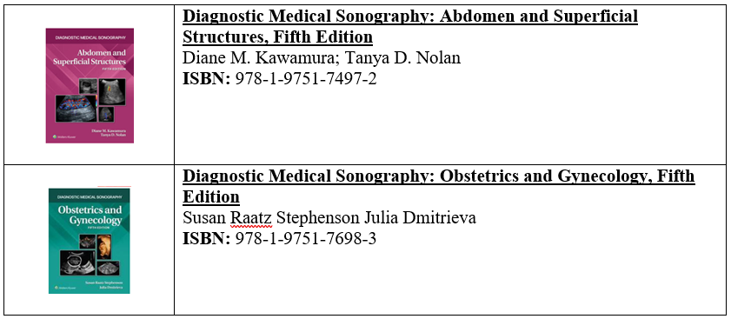
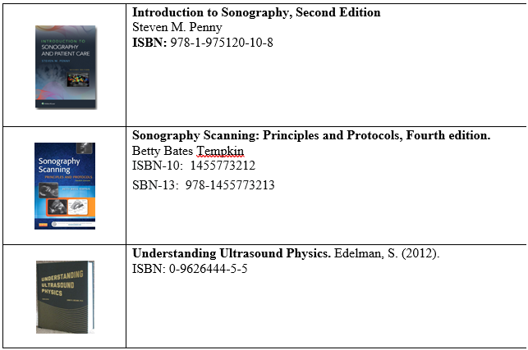
Booklist
Notes:
This is our textbook list for you to review. Please don’t purchase it until you are in the program.

Slide 60
Financial Planning
Work schedule
Financial Aid
  Financial Aid & Scholarships | Houston City College
  Application Deadline: March 1st
Scholarships
  Scholarships | Houston City College
If you need financial aid assistance, please call 713.718.2000, option 2, Monday-Thursday, 8 a.m.-6 p.m. and Friday, 8 a.m.-5 p.m., or visit www.hccs.edu/applying-and-paying/financial-aid/.
Pay tuition at the Orientation Session and on the last day of the previous semester
Notes:
We want you to be prepared for this program, so please make sure to plan out your finances before applying for this program.

Slide 61
Waiting List
We do not have a waiting list. If you are placed in the alternative list, there is a possibility to be accepted in the program. We call students in the alternative list to replace students who have denied the acceptance letter.
You need to submit the updated DMSO program application for the following admission deadline
Notes:
We do not have a waiting list. You can be placed in the alternative list, which means we can call you to join the program should anyone deny the acceptance letter.

Slide 62
Sonography Student Success
  Degree/major earned after completion of the program
  ATC or AAS
Graduates are expected to apply to take the national credentialing exams immediately upon graduation
  American Registry for Diagnostic Medical Sonography (ARDMS)
    ARDMS exam is highest regarded exam available
    RDMS credential = physics exam plus a specialty exam
    Specialties this program prepares a graduate for include:
      Abdomen/Superficial Structures
      Obstetrics and Gynecology
  The American Registry of Diagnostic Radiologic Technologists (ARRT)
    One exam that includes abdominal, pelvis, OB/GYN, superficial structures, non-cardiac chest, and ultrasound physic
Review and registry preparation activities are included in curriculum
Notes:
Once you finish the DMSO program, you can take the registry with the ARDMS or the ARRT. The ARDMS requires that each specialty is taken individually. In contrast, the ARRT is given with everything in one exam. Completion of this program enable you to be certified in abdominal/superficial structures and obstetric and gynecology, which are two certifications instead of one.
The review and registry preparation activities are included in the curriculum.

Slide 63
Undertaking Commitment
In the program
  Read all textbooks
  Dedicate 20 hours a week to study (outside of class)
  Able to take constructive criticism
  Embrace change (schedule, environment, etc.)
After graduation
  Active in job search
  Willing to work at odd shifts (evenings, weekends, holidays, and calls)
  Willing to relocate to another state for employment opportunities
  Willing to continue to study and taking more registries
Notes:
We surveyed our students and asked what they did to be successful in this program. This is their answers. Can you do the same so you can be successful, also?

Slide 64
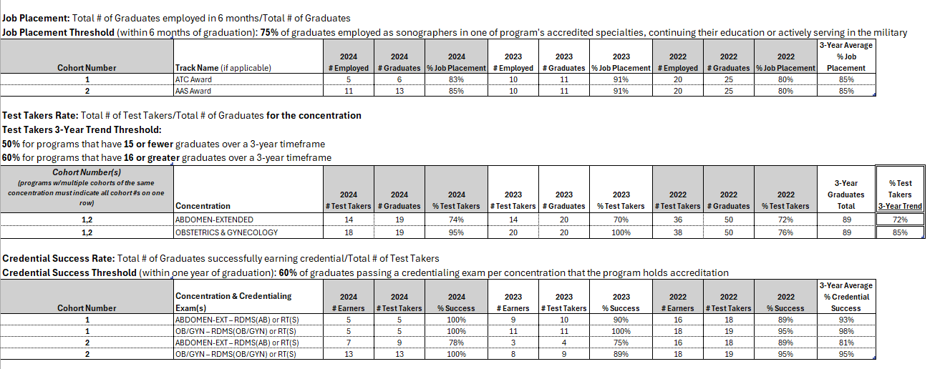
Student Outcomes
Notes:
This is our student outcome report regarding Job Placement, Test Taker, and Credential Success Rate.

Slide 65
Transfer Students from another Ultrasound School
We do not have a transfer policy. Students must apply for this program as a new student.
Notes:
We do not have a transfer policy. Students must apply for this program as a new student.

Slide 66
Q&A Session
If you have questions, join a live instructor on the last Monday of every month, at noon, in the virtual world for Q&A.
Except when the college is out on holiday, e.g. in December
Virtual World for Q&A: https://framevr.io/hccsonography
Notes:
If you have questions, join a live instructor on the last Monday of every month, at noon, in the virtual world for Q&A.

Slide 67
Videos
TESTIMONIAL VIDEO
https://drive.google.com/drive/folders/1SQKUJd0Ta_NEpCGoha1mJbp7xc_jPimL
INFORMATION SESSION MODULE
https://drive.google.com/drive/folders/1HZvh6GkUbYjv-sF_3MPT4I9EGBAEquIf
Notes:
This is just additional recourses for you to review.

Slide 68
Additional Information
Society of Diagnostic Medical Sonography (SDMS)
  Professional Society
  www.sdms.org
American Registry for Diagnostic Medical Sonography (ARDMS)
  Sonographer credentialing organization
  www.ardms.org
American Registry of Radiologic Technologists (ARRT)
  Sonographer credentialing organization
  https://www.arrt.org/
Joint Review Committee on Education in Diagnostic Medical Sonography (JRC/DMS)
  programmatic accreditation
  http://www.jrcdms.org/
Commission on Accreditation of Allied Health Education Programs (CAAHEP)
  programmatic postsecondary accrediting agency
  https://www.caahep.org/
  Look for other ultrasound school in the Houston Area
Notes:
Additionally, I want to share this slide with you, which includes links containing important information about the Sonography profession.

Slide 69
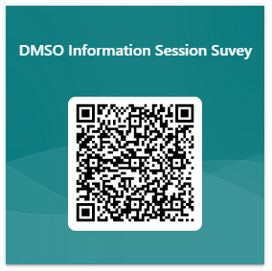
Complete survey for proof that you have reviewed this PPP
https://forms.office.com/r/fbtKqtqXbe
Notes:
Please complete this survey to show that you have completed the information session.
If you have any questions, please feel free to contact me at Elizabeth.ho@hccs.edu
Thank you!

